Slide 1
Introduction to Communication Skills
Lecture 1
By Ms. Maria Ghani

Slide 2
Communication Skills
Communication skills are a critical element in delivering effective training.
Individuals must be able to use a variety of communication techniques in order to create an environment that enables participants to engage actively in the learning process.

Slide 3
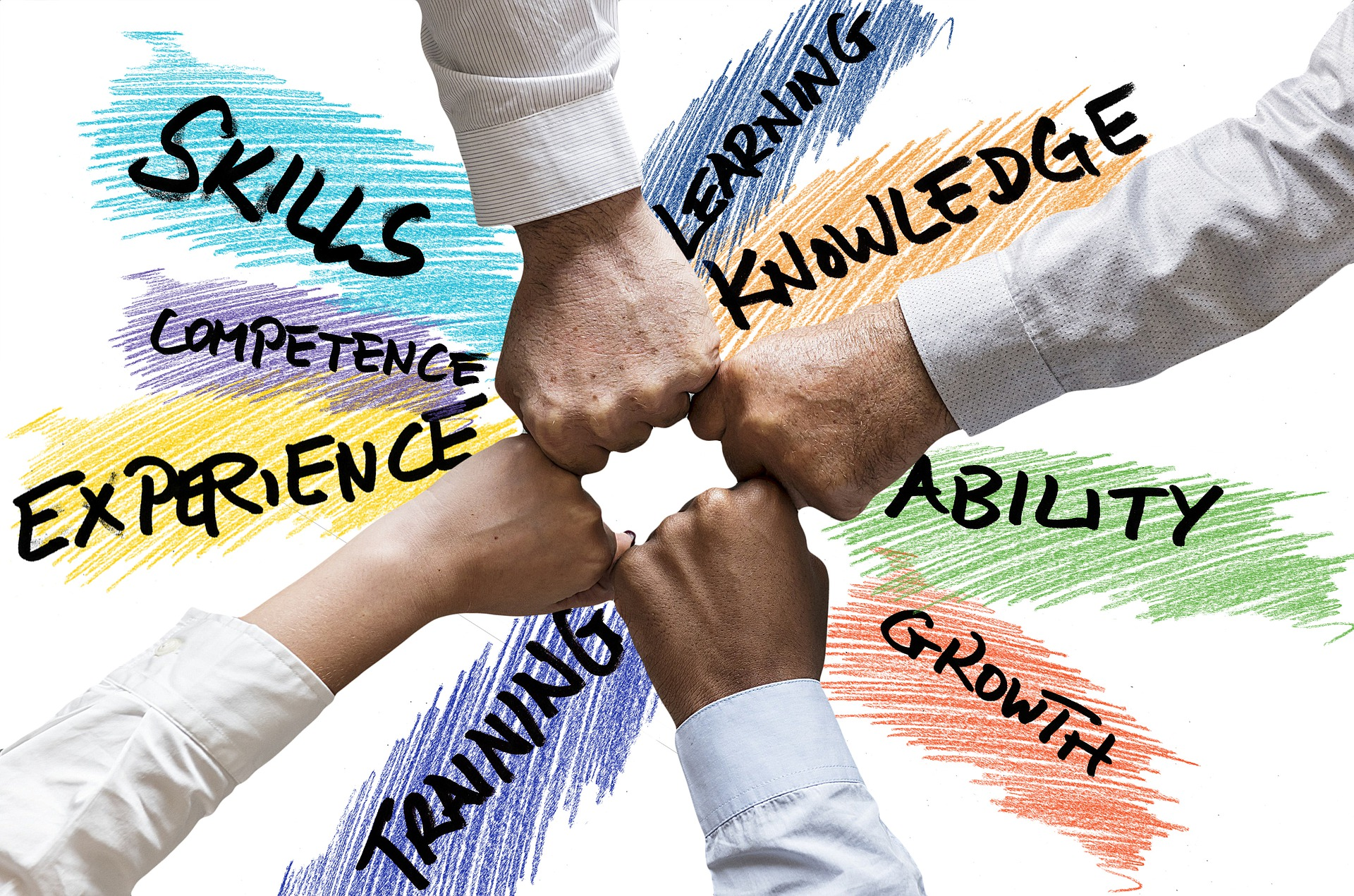

Slide 4
What are the most common ways we communicate?
Spoken Words
Visual Images
Written Words
Body Language

Slide 5
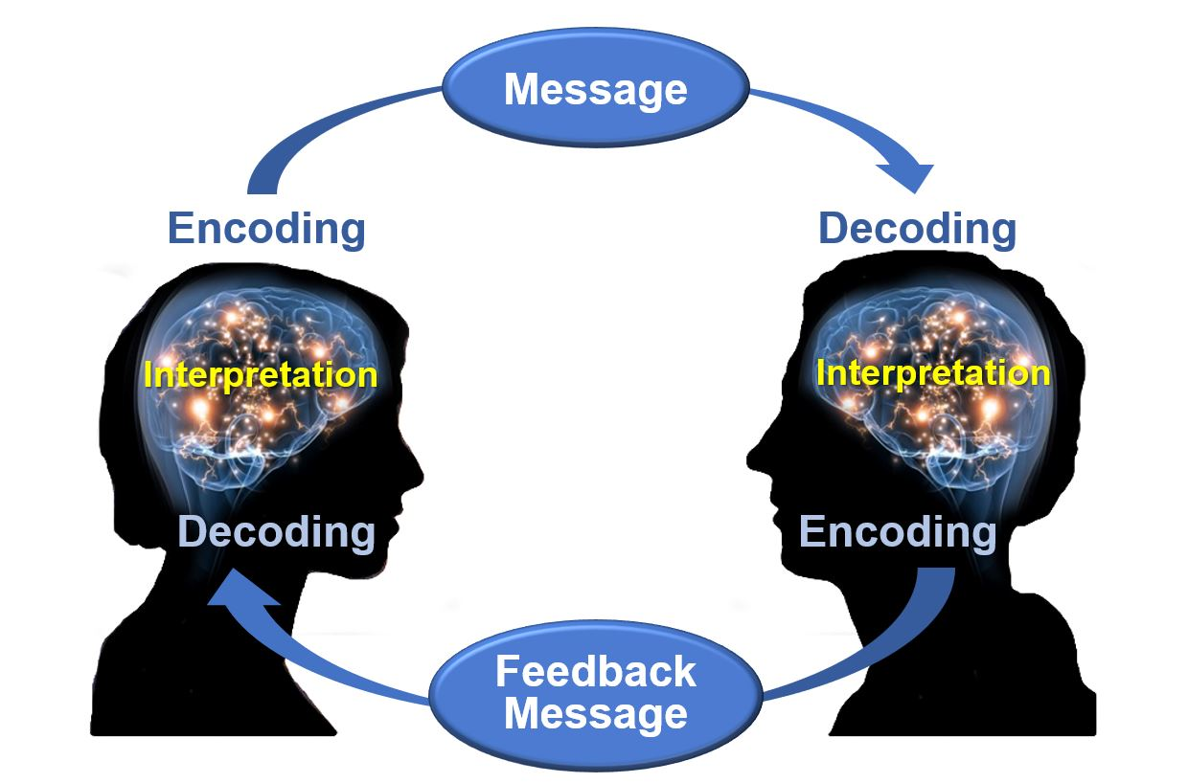

Slide 6
Components of Communication
Context
Internal Means
External Means
Sender (Encoder)
Message
Medium
Receiver (Decoder)
Feed Back

Slide 7
1. Context
Context tells us reason for communication and reasons may be
Internal
External

Slide 8
Cont…..
Internal means a company wants to Discuss an idea/Issue to its employees – the message should be either in writing or verbal
In eternal context –some query from stakeholders or from outside the organization-
You may response to query
Email
Fax
Telephone
Letter
Verbal etc.

Slide 9
2. Sender (Encoder)
When you’re sending the message, you are the “Encoder” .
Here the word you mean writer/Speaker decides whether the message should be in written or oral. He/She may choose Words, Symbols, Pictures or Graphics that express the objective in the real sense.

Slide 10

3. Message
Message is basically the basic idea that you want to communicate.
The message may be
Verbal, means (Written or Spoken)
Non-Verbal, means( Symbols, Pictures or unspoken).

Slide 11
Cont…..
This is very much important component of communication “ Your message should be or MUST be clear and easy to understand”
The most important element in message is your receiver . You must be well aware about your receiver.
While preparing a message you should keep in mind how your receiver will interpret the message.

Slide 12
Cont…..
You (Sender) should also keep in mind your relationship with the receiver while preparing message.
some times wrong message may create a loss to your organization , to yourself.
or it can create a bad impression for you/your company.

Slide 13
4. Medium
Medium is basically channel through which your message reaches to receiver & channel vary from situation to situation.

Slide 14
Cont…..
E.g. Let’s say Govt of Pakistan wants to convey its message to Pakistani Nation , now Govt will select the effective medium it may be.
T.V
Radio
Papers
Or all of the above “keeping in view the Importance of the message.”
When we talk at Micro /Organizational Level the medium may be writing or non-Verbal

Slide 15
5. Receiver (Decoder)
To whom the message is being sent.
e.g. in case of Govt of Pakistan's Message, Pakistani Nation is receiver (Decoder).
In simple words we can say that receiver is your reader (in case of press , letters etc.) or Listener (In case of TV, radio, Speaker Etc.)
Receiver is also known as decoder.

Slide 16

6. Feedback
Feedback is basically the response/reaction of Receiver after receiving the message.
Sender always need feedback to check weather the message effectively reached or not…? Or in other words….
Sender needs feedback to examine the success or failure of the message.

Slide 17
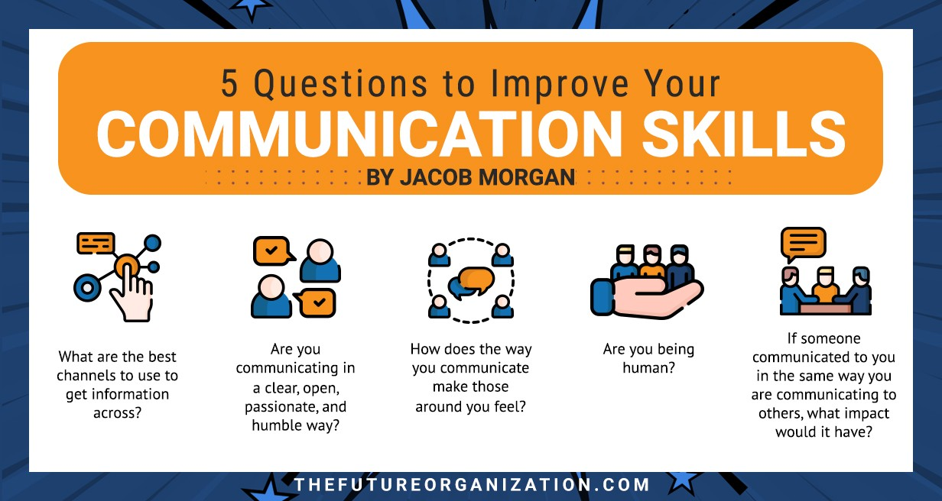

Slide 18


